Slide 1
Mitigation Strategies

Slide 2
Learning Objectives
What is Mitigation in information security ?
Why Mitigation in information security is important?
Mitigation Strategies
Category of Mitigation Strategies
Mitigation Strategies Example

Slide 3
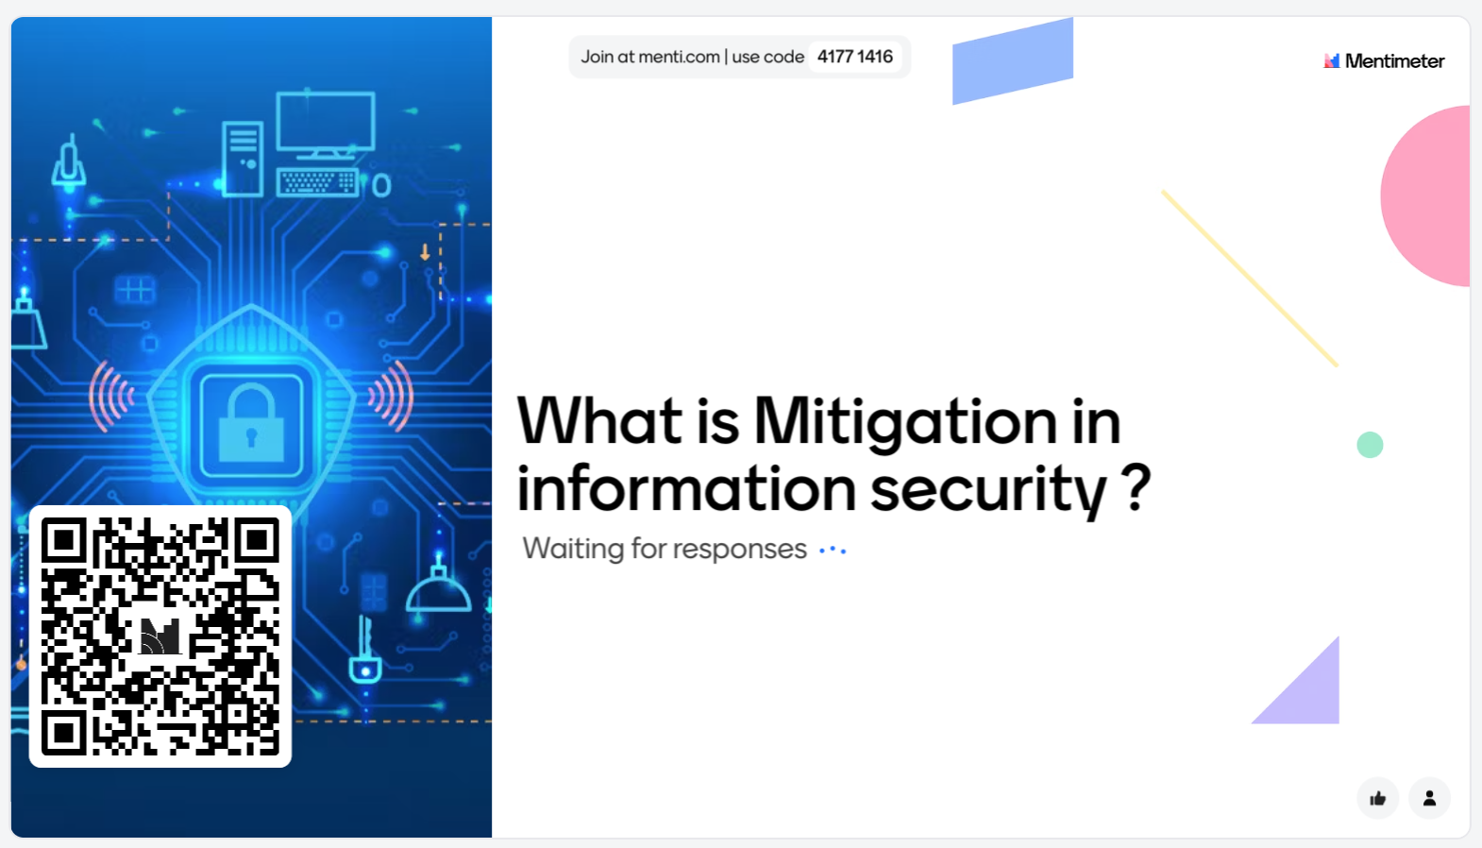
What is Mitigation in information security ?
Notes:
Encryption
Decryption
Security
Confidentiality
Algorithms
Keys
Ciphers
Privacy
Cryptanalysis
Protection
Information
Communication
Confidential
Authentication
Integrity
Cryptosystem
Key exchange

Slide 4
What is Mitigation in information security ?
Mitigation in information security means implementing strategies, tools, and actions to reduce the impact of potential security risks or incidents.
Mitigation in information security refers to the steps and actions taken to reduce the risk and impact of potential security threats to information systems.
The goal of mitigation is to reduce the likelihood that a security incident will occur and to minimize the damage if one does happen.
Notes:
Communication is the process of exchanging information
set of rules designed to perform a specific task or solve a particular problem.

Slide 5
Why Mitigation in information security is important?
Mitigation reduces the chances of unauthorized people getting into your computer stuff.
Cost Savings: It saves you money because fixing problems is more expensive than preventing them.
It keeps your important information safe, accurate, and available when you need it.
Following security rules helps you avoid fines and penalties.
Notes:
Communication is the process of exchanging information
set of rules designed to perform a specific task or solve a particular problem.

Slide 6
Mitigation Strategies
Mitigation strategies in information security refer to the measures and actions taken to reduce risks and potential damage associated with various security threats and vulnerabilities.
Mitigation strategies can depend on the specific threats and vulnerabilities faced by an organization.
Notes:
Communication is the process of exchanging information
set of rules designed to perform a specific task or solve a particular problem.

Slide 7
Category of Mitigation Strategies
Prevention: These strategies aim to prevent security incidents from occurring in the first place.
They often involve implementing security controls and best practices to reduce the likelihood of an attack or breach. Examples include:
Firewalls and intrusion prevention systems (IPS) to block unauthorized access.
Regular software patching and updates to address known vulnerabilities.
Strong access controls and authentication mechanisms to limit unauthorized access.
Notes:
Communication is the process of exchanging information
set of rules designed to perform a specific task or solve a particular problem.

Slide 8
Category of Mitigation Strategies
Detection: Detection strategies focus on identifying security incidents as they happen or shortly after they occur. Common detection measures include:
Security monitoring and log analysis to detect unusual or suspicious activities.
Intrusion detection systems
Notes:
Communication is the process of exchanging information
set of rules designed to perform a specific task or solve a particular problem.

Slide 9
Category of Mitigation Strategies
Response: Once a security incident is detected, an organization must have a plan and procedures in place to respond effectively. Mitigation strategies in this category include:
Incident response plans detailing how to handle different types of security incidents.
Preventing further damage by containing and isolating compromised systems.
Notes:
Communication is the process of exchanging information
set of rules designed to perform a specific task or solve a particular problem.

Slide 10
Category of Mitigation Strategies
Recovery: After an incident has been resolved, recovery strategies focus on restoring normal operations and minimizing the impact on the organization. Key components of recovery include:
Data backups and disaster recovery plans to restore lost data and services.
Notes:
Communication is the process of exchanging information
set of rules designed to perform a specific task or solve a particular problem.

Slide 11
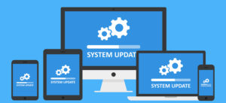
Patch Management
Patch Management: Regularly update and patch operating systems, software applications, and network devices to address known vulnerabilities.
Timely patching helps close security gaps that could be exploited by attackers.
Notes:
Communication is the process of exchanging information
set of rules designed to perform a specific task or solve a particular problem.

Slide 12
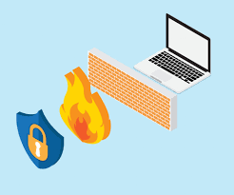
Firewall
A firewall is a network security device or software application that is designed to monitor, filter, and control incoming and outgoing network traffic based on security rules.
The main role in protecting sensitive information, preventing unauthorized access, and safeguarding against a wide range of cyber threats, including malware, viruses, DoS attacks
Notes:
Communication is the process of exchanging information
set of rules designed to perform a specific task or solve a particular problem.

Slide 13
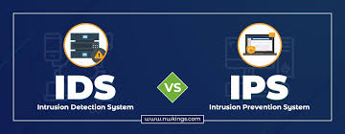
IDS & IPS
Intrusion Detection Systems (IDS) only detect unusual suspicious activities in the network and then reports to IT and security teams.
Intrusion Prevention Systems (IPS) detect suspicious activities in the network and block it saving the job of the security teams to focus on more complicated things.
Notes:
Communication is the process of exchanging information
set of rules designed to perform a specific task or solve a particular problem.

Slide 14

Difference Between IDS and IPS
Notes:
Communication is the process of exchanging information
set of rules designed to perform a specific task or solve a particular problem.

Slide 15

Access Control
Access Control: Implement strong access control mechanisms to ensure that only authorized users have access to sensitive data and resources.
This includes user authentication, authorization, and auditing.
Notes:
Communication is the process of exchanging information
set of rules designed to perform a specific task or solve a particular problem.

Slide 16

Security Awareness Training
Security Awareness Training: Educate employees and users about security best practices, phishing awareness , social engineering attacks, and the importance of strong passwords.
Notes:
Communication is the process of exchanging information
set of rules designed to perform a specific task or solve a particular problem.

Slide 17
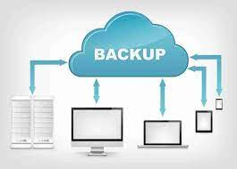
Data Backups
Data Backups:
Regularly back up critical data and systems to ensure data recovery in case of data breaches or system failures.
Test data backups to verify their integrity and reliability.
Notes:
Communication is the process of exchanging information
set of rules designed to perform a specific task or solve a particular problem.

Slide 18
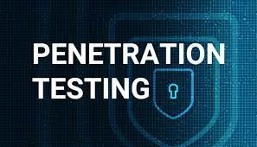
Vulnerability Scanning and Penetration Testing:
Vulnerability Scanning and Penetration Testing:
Conduct regular vulnerability assessments to identify and remediate security weaknesses.
Perform penetration testing to simulate attacks and identify vulnerabilities before malicious actors can exploit them.
Notes:
Communication is the process of exchanging information
set of rules designed to perform a specific task or solve a particular problem.

Slide 19
Security Monitoring and Logging
Security Monitoring and Logging: Continuously monitor network and system activities and maintain detailed logs.
Analysing logs helps detect anomalies and security incidents in real-time.
Notes:
Communication is the process of exchanging information
set of rules designed to perform a specific task or solve a particular problem.

Slide 20
Physical Security
Physical Security:
Secure physical access to data centre, server rooms, and other critical infrastructure.
Implement security measures like biometric access controls, surveillance cameras, and environmental controls.
Notes:
Communication is the process of exchanging information
set of rules designed to perform a specific task or solve a particular problem.

Slide 21
Cloud Security
Cloud Security:
Apply security best practices when using cloud services, including strong authentication, encryption, and access controls.
Monitor cloud environments for security threats and vulnerabilities.
Notes:
Communication is the process of exchanging information
set of rules designed to perform a specific task or solve a particular problem.

Slide 22
Activity
Use the internet and academic sources to research about the vulnerabilities in each device that mention in case study :
Windows 7 , windows 10 , Windows Server 2016 and 2019
How to Mitigate these vulnerabilities

Slide 23
What’s next on the agenda?
Break: 20 minutes
Lab Explanation
Lab Work

Slide 24


